Slide 1
Object Oriented Programming for Computer Science
Dr Michael Meredith
Week 7: Standard Template Library

Slide 2

Topics for Today
Standard Template Library (STL)
That is all... just the Standard Template Library
... no really, that is all we are doing today.. the STL

Slide 3
Standard Template Library
Generic C++ library of useful stuff
Data Structure
Algorithms
Efficient/optimised code
But very generic in its level of abstraction
Templates are used for arbitrary data types (including classes)
We'll look at creating our own templates in due course
Useful, but tricky at the same time
This isn't Object-Oriented Programming
Think of it more as generic programming
You have used the STL in the form of a vector in FoP4CS
... but there is so much more to explore and discover

Slide 4
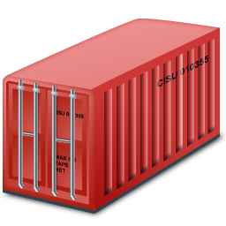
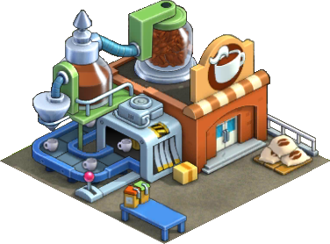
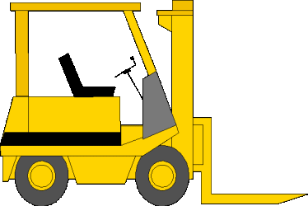
STL: The Structure
Data and operations are separated from each other
You have containers that hold the data
You have operations that implement algorithms
You need a go-between to allow the operations to access the data in a meaningful way
These are called iterators
Allow any data container to work with any algorithmic operator
Completely uncoupled structure

Slide 5
STL: The Structure
Data and operations are separated from each other
You have containers that hold the data
You have operations that implement algorithms
You need a go-between to allow the operations to access the data in a meaningful way
These are called iterators
Allow any data container to work with any algorithmic operator
Completely uncoupled structure
container
algorithm
iterator
container
iterator
container
iterator

Slide 6
STL: Containers
Fundamental Data Structures
Vector
Linked Lists (single and double)
Queue
Priority Queue
Stack
Set
Map
Hash map
…
The STL provides code for their implementations
No need to code their behaviour (i.e. ADS2), just use them off-the-shelf
vector<int> vi(6, 0);
for (int i(0); i < 6; ++i)
vi[i] = i;
for (size_t i(0); i < vi.size(); ++i)
cout << vi.at(i) << ' ';

Slide 7
STL: Containers
What have we learnt in ADS2 about different types of containers?
Considering the sequence containers of Vectors and Linked Lists:
Which is more efficient for adding?
Which is most efficient for inserting?
Which is most efficient for sequential access?
Which is most efficient for random access?
Which is most efficient for deleting an item?

Slide 8
STL: Containers
There are also Associative Containers
Sorted collections
Typically built using trees (the specific detail will be deferred for your ADS2 sessions)
Examples of STL Associative Containers include:
Set: duplicates not allowed
Multiset: duplicates allowed
Map: <key, value> pairs, sorted on key. Duplicates not allowed
Multimap: <key, value> pairs, sorted on key. Duplicates allowed
Different containers have different pros and cons
This is covered in detail in ADS2

Slide 9
STL: Iterators
Mechanism to traverse elements of a container
include <iterator>
Represents a specific position in a container
Iterator types
Input: sequential read
Output: sequential write
Forward: read/write but going forward
Bidirectional: read/write, forward/backward
Random Access: access that is random
Look a little like pointers
Implementation dependant on the data structure
Think about ADS2
vector<int>::iterator it(vi.begin());
while (it!=v.end())
cout << *(it++);

Slide 10
STL: Iterators
Containers define their iterators with a set of public methods
operator* : container item at the current position
operator-> : access member functions of current item
operator== : determines the equivalence of two iterator positions
operator++: increments the iterator position
operator!= : not of ‘==‘
operator= : assign a position to an iterator
begin() : returns an iterator representing the first item
end(): returns an iterator representing the “past the end” item

Slide 11
STL: Iterators
Let’s consider the following examples:
Each iterator should define a const and non-const version
list<int> numbers;
for (int i=0; i<13; i++)
numbers.push_back(i);
list<int>::iterator it(numbers.begin());
while (it!=numbers.end())
*(it++)=(*it)*(*it);
list<int>::const_iterator cit(numbers.begin());
while (cit!=numbers.end())
cout << *(cit++) << ' ';
Forward iterator (read/write)
Input iterator (read only)

Slide 12
STL: Algorithms
Process data in containers (via iterators) for a specific purpose
include <algorithm>
Work on iterator half-open ranges [being, end)
Algorithms include:
Move
Count
Find
Sort
Merge
Search
And many more… for a complete list of those provided, see: https://docs.microsoft.com/en-gb/cpp/standard-library/algorithm-functions

Slide 13
STL: Algorithms
Examples of algorithms:
list<int> numbers;
...
int sum=accumulate(numbers.cbegin(), numbers.cend(), 0);
cout << "Sum " << sum << "\n";
reverse(numbers.begin(), numbers.end());
vector<int> res(13, 0);
copy(numbers.begin(), numbers.end(), res.begin());
vector<int> res2;
copy(numbers.begin(), numbers.end(), back_inserter(res2));
Note the difference

Slide 14
STL: Iterator Adapters
Iterator Adapters
Insert Iterator
vector<int> res2;
copy(numbers.begin(), numbers.end(), back_inserter(res2));
Stream Iterator
copy(res2.cbegin(), res2.cend(), ostream_iterator<int>(cout, " "));
list<string> input;
copy(istream_iterator<string>(fin), istream_iterator<string>(), back_inserter(input));
Reverse Iterator
rbeing() / rend()

Slide 15
STL: More Advanced Stuff
Some algorithms take functions as parameters
bool divByThree(int value) { return (value%3)==0; }
int c=count_if(numbers.cbegin(), numbers.cend(), divByThree);
With Objects
bool beforeMyTime(const MyTime& lhs, const MyTime& rhs) {
return (lhs.hours<rhs.hours /* ...*/);
}
vector<MyTime> times;
// ...
sort(times.begin(), times.end()); // assumes operator<
sort(times.begin(), times.end(), beforeMyTime);
There are also bind function adapters that allow parameters to be passed

Slide 16

STL: Criticisms
Some containers provide functions that provide better performance than generic algorithms
erase(list) vs list.remove(…)
Break the STL model and requires deep understanding of STL
STL are implemented with templates and compiler errors are almost indecipherable and very long
Potential of code bloat (due to templates)
A different way of thinking to OO
Increase compile time
But they are still a useful body of code for rapid code development without having to write your own classical algorithms and data structures

Slide 17

Standard Template Library
Today was all about the Standard Template Library
Containers
Iterators
Algorithms
Adapters

